Slide 1
FABLE:
Happy mother’s day, dear Dragon.
Read and listen

Slide 2
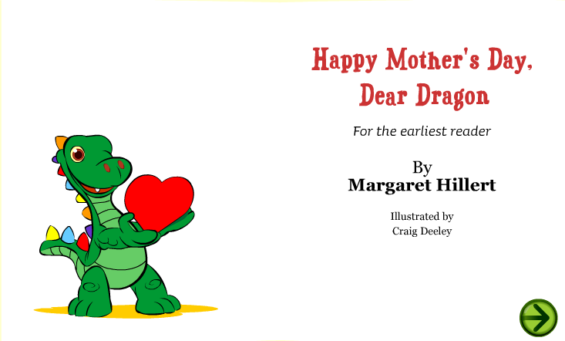
Go to http://www.starfall.com/n/fiction-nonfiction/mothers-day/load.htm?f, and complete next sentences.
(you can listen to the fable, try to do it)

Slide 3
Go to every page and the complete the next questions or requirements, according to the tense (present or past), give complete and long answers.
Pages | ACTIVITY | ANSWER
1 and 2 | What happened?
3 and 4 | What did he want?
5 and 6 | Which verbs did you identify?
7 and 8 | Where are they?
9 and 10 | Describe the situations
11 and 12 | What did the boy say to the pet?
13 and 14 | What happened?
15 and 16 | Why is she happy?
17 and 18 | Who loves whom?
19 and 20 | What happened with the father?
21 and 22 | What did the boy have in his hand?
23 and 24 | Why were they happy?

Slide 4
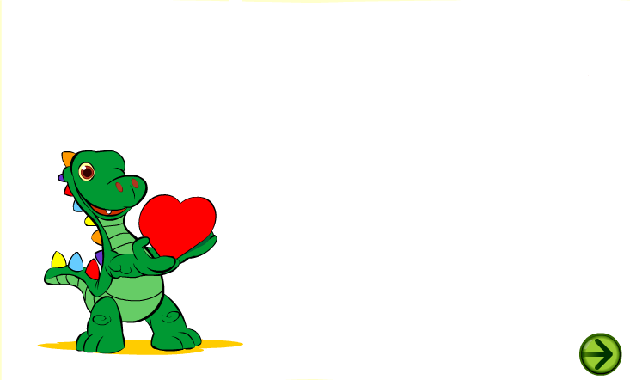
Write 5 question s about the fable, they can be in present, past or future
QUESTIONS
1.
2.
3.
4.
5.
Give another title to the fable:
Title:

