Slide 1
Level 3
Student’s name:

Slide 2
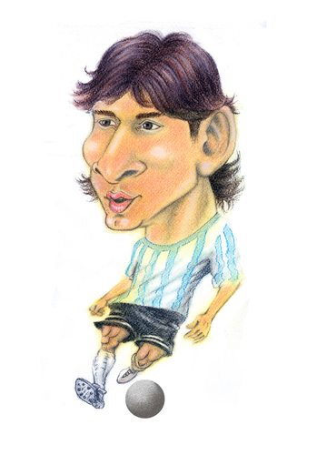
Use the superlative to describe 7 people around the world. Use short, large and irregular adjectives, send the pronunciation:
 | Messi is the most talented soccer player | Messi es el futbolista más talentoso
ENGLISH | SPANISH
1
2
3
4
5
6
7

Slide 3
Following next examples, make a sentence and then give an advice by using SHOULD
Send the pronunciation
1. My computer is very old
ADVICE: you should buy a new one
2. My parents are sick
ADVICE: they should go to the doctor
Sentence | Advice
1.
2.
3.
4.
5.
6.
7.
8.

