Slide 1
Level 3
Student’s name:

Slide 2
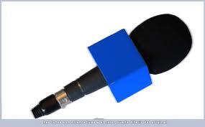
Describe what your family members, neighbors, etc, are doing right now:
Who? | What’s he/she doing?
My mom | She is talking on the phone and getting ready to visit some relatives.
My brother
…

Slide 3
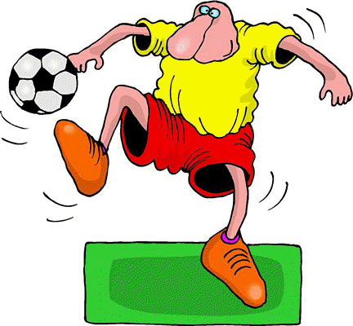
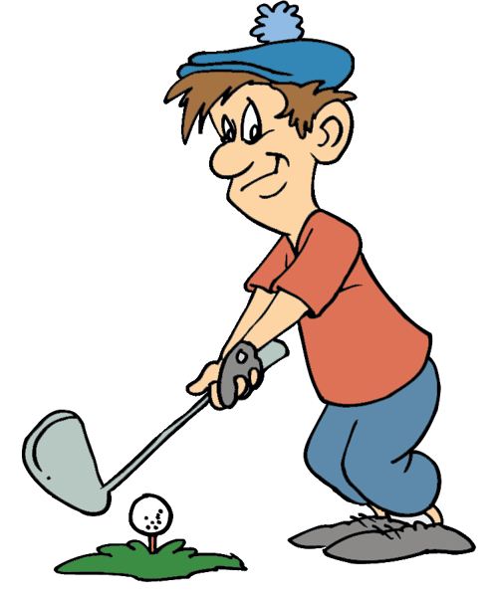
Paste 8 images or photos and compare them by using large, short and irregular adjectives, then pronounce:
Image 1 | Sentence | Image 2
Tomado de: glogster.com | Soccer is more famous than golf (el fútbol es más famoso que el golf) | Tomado de: kniakrls.com

Slide 4
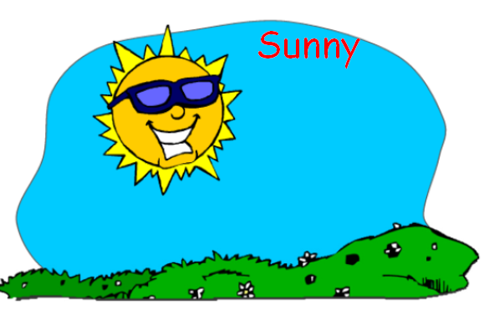
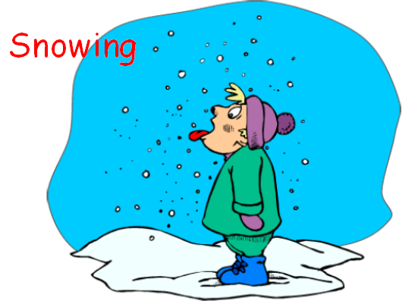
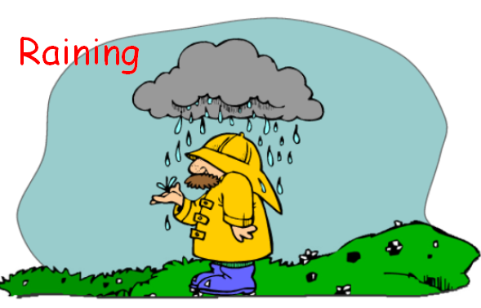
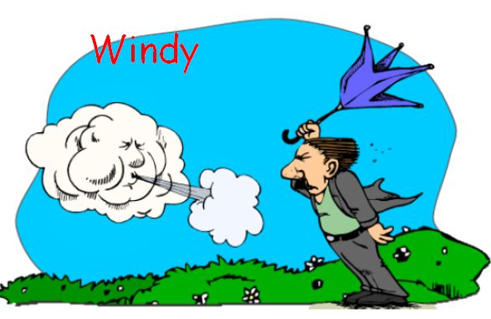
According to the images, write the months for each one:
June, July….

Slide 5
Describe months, days, tv programs, sports and hobbies, using comparative adjectives:
Compare
Months:
Days:
(example) Friday is better | (example) Monday is more boring
TV programs
Sports
Hobbies

Slide 6
Resources:
video: how to compare
http://www.youtube.com/watch?v=dBAn-1x95Mk
Exercises to compare
http://www.ego4u.com/en/cram-up/grammar/adjectives-adverbs/adjectives/exercises
explanation: present continuos tense
http://www.englishpage.com/verbpage/presentcontinuous.html
practice: present continuos tense
http://www.eclecticenglish.com/grammar/PresentContinuous1F.html

