Slide 1
Comparative of equality
Polite expressions
Giving instructions
Describing feelings
Expressing addition, cause and effect

Slide 2



Paste two images and write 5 comparative sentences using to be + AS . . . AS
Lisa is as young as Bart Bart is not as intelligent as Lisa | Lisa es tan joven como Bart Bart no es tan inteligente como Lisa

Slide 3

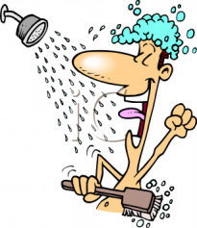
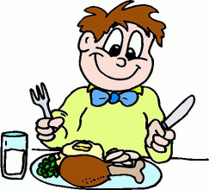



Give instructions, in English and Spanish, using images and verbs. Follow the model.
Write a title: how to study at Cibercolegio
First | second | then | later | After that | And finally
Get up | Take a shower | Eat breakfast | Turn on your PC | Do the tasks | Send the file
Primero: Levántese | Segundo: Tome un baño | Luego: Desayune | Más tarde: Encienda su PC | Después de eso: Haga las tareas | Y finalmente: Envíe el archivo
Title: How to . . .
first | second | then | later | After that | And finally
Primero: | Segundo: | Luego: | Más tarde: | Después de eso: | Y finalmente:
verbo
imagen

Slide 4
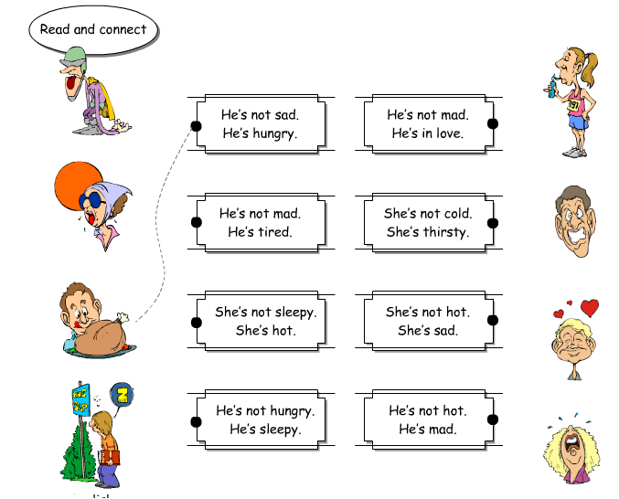
Activity. Connect the sentences with the corresponding images, then send the pronunciation

Slide 5
Make sentences using verbs and adjectives from list in “adjetivos y verbos, causa, adición, efecto”, then send the pronunciation
 | Because
They are eating | because | They are hungry
Ellos están comiendo | porque | Ellos están hambrientos (tienen hambre)
1.
2.
3. | and
She is sad | and | He is Nervous
Ella está triste | y | Él está nervioso
1.
2.
3. | But
He isn’t happy | but | He is smiling
Él no está feliz | pero | Él está sonriendo
1.
2.
3.

