Slide 1
Personal information
Game: present continuous tense
Temporal order.
Comparative of equality

Slide 2

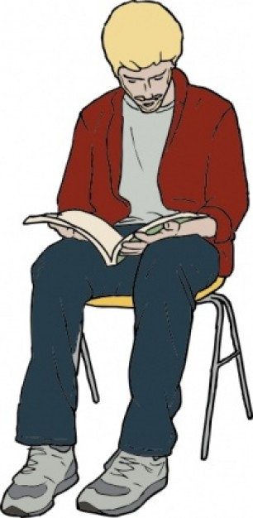
Activity. Complete the information, according to the next biography.
 | He is Henry
 | His last name is Watts
 | He is from Canada
 | He was born in Ottawa
 | His parents are Geraldine and William
 | He lives at 40 Milton Close, Toronto
 | He is 22 years old
 | His birthday is on October 2nd
 | He is a student
 | He likes video games, hamburgers and sports
 | He dislikes fish, mathematics and horror movies
Information
Occupation:
Likes:
Age:
Birth: | October 2nd
Nationality :
Residence:
Name:
Parents:
Last name:
Dislikes:

Slide 3
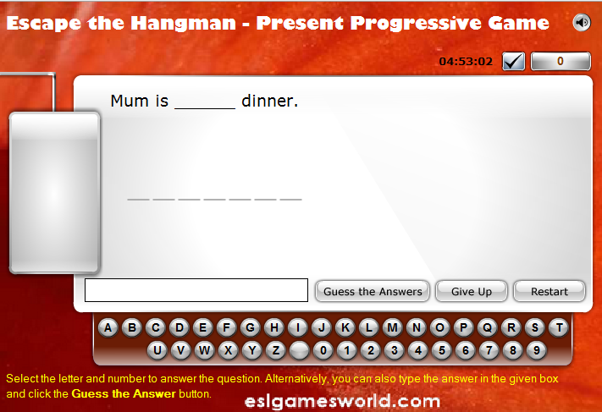
ACTIVITY. Go to: http://www.englishmedialab.com/GrammarGames/present%20tenses/present%20progressive%20hangman.html , complete each sentence, click in next puzzle, and when you finish, write in order all the 10 sentences:
1. Mum is cooking breakfast

Slide 4
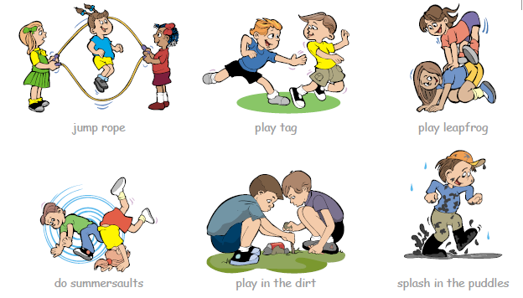
Describe 6 images from “juegos infantiles”, using temporal order.
First, they jump role; second, they play tag; then, they play leapfrog; later, they do summersaults; after that, they play in the dirt and finally he splash in the puddles.

Slide 5
Compare using AS … AS according to the first sentences. Follow the examples.
John’s father is handsome and so is John | John is as handsome as his father John es tan atractivo como su padre
El padre de John es atractivo y así es John
Sandra’s mother is generous and so is Sandra
La madre de Sandra es generosa y así es Sandra
Albert’s brother is intelligent and so is Albert
El hermano de Alberto es inteligente y así es Alberto
Mary drives fast and so does Helen
Mary conduce rápido y así lo hace Helen
Our home is comfortable and so is yours
Nuestra casa es cómoda y así es la tuya
Jenny works hard and so does Betty
Jenny trabaja duro y así lo hace Betty
Jack can run fast and so can Jill
Jack puede correr rápido y así lo puede hacer Jill

