Slide 1
Personal information the time spelling

Slide 2

My biography
Activity. Complete and pronounce your personal information
Your photo | PERSONAL INFORMATION
 | My name is
 | My last name is
 | I am from
 | My birthday is on
My telephone number is
I am years old
My favorite music is
My favorite sport is
My hobby is

Slide 3
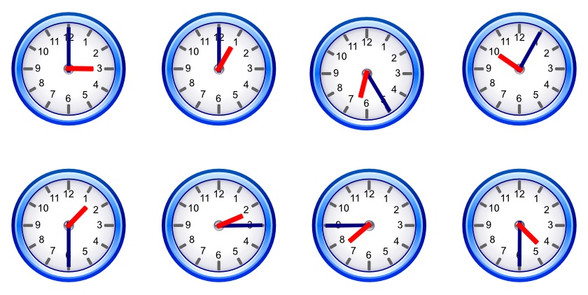
The time
Activity. Write and pronounce the next 8 hours, according to the links below.
Ingrese al siguiente enlace para escuchar la pronunciación.
http://www.languageguide.org/english/vocabulary/time/
Analice la escritura y pronunciación de las horas en el siguiente enlace:
http://www.languageguide.org/english/telling-time/

Slide 4
Spell activity. Spell next words by pronouncing them.
 | PRONOUNCE
Spell your name
Spell your last name
Spell your mother’s name
Spell your father’s name
Spell CIBERCOLEGIO | C-I-B-E-R-C-O-L-E-G-I-O
Spell your favorite class
Spell your favorite sport
Spell your favorite day

