Slide 1
Likes and dislikes
My family
Every day actions
Days of the week

Slide 2

Activity 1. Write and pronounce what you like and dislike (2 for each one: 20)
Category | LIKES I like. . . | DISLIKES I dislike . . .
Food | Example: hot dogs | Example: Cheese
Color
Sport
Vegetables
Farm animals

Slide 3
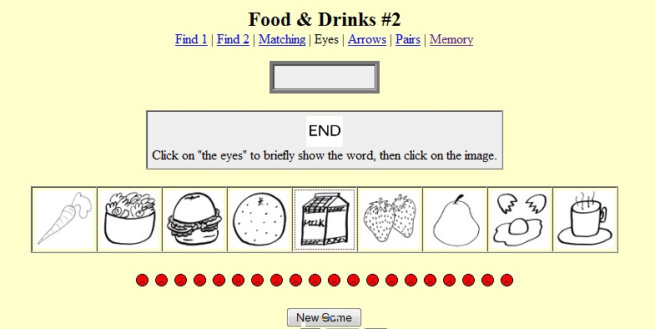
Activity 2. Play, complete the game and send the image when you finish:
http://www.manythings.org/lulu/g4.html#
Example:
Correct: green color

Slide 4
Activity 3. Complete the blanks and pronounce.
Member of my family | name | action | day | Part of the house / city
1. Father |  | Work |  | school
2.
3.
4.
5.
6.

