Slide 1
Level 2
Student’s name:

Slide 2
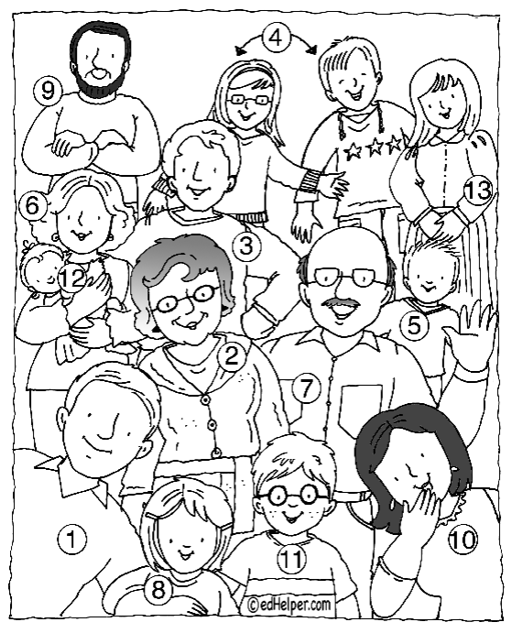
Write , in English, the relationship of each member of your family, according to the number
 | Relationship (parentesco)
1
2 | Grandmother
3
4
5
6
7
8
9
10
11
12
13

Slide 3
Watch this video, the clothing and the characteristics of each season, then complete: http://www.youtube.com/watch?v=aIWBED84g6s
 | Characteristics | clothing
Winter | Rainy
Fall
Summer |  | Sunglasses
Spring

Slide 4
Ressources:
Family members:
http://www.youtube.com/watch?v=GGqOUwh6V-A
The weather:
http://tv.mes-english.com/weather.php

