Slide 1
Greetings and spelling

Slide 2
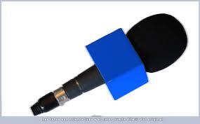
ACTIVITY 04: write and pronounce the Greetings and take leavings in next video:
http://www.youtube.com/watch?v=2J0joO_TVNQ&p=DA9C74CC2F07DAA8&playnext=1&index=24
ENGLISH | SPANISH
1. Good morning | Buenos días
2.
3.
4.
5.
6.
7.
8.

Slide 3
ACTIVITY : Spell the next information
Example
Spell the capital city of Colombia: BI – OU – GI – OU – TI – EI (Bogotá)
Spell your name
Spell your last name
Spell your father’s name
Spell your mother’s name
Spell your favorite city in Colombia
Spell your favorite class
Spell your hobby

