Slide 1
Level 2
Student’s name:

Slide 2
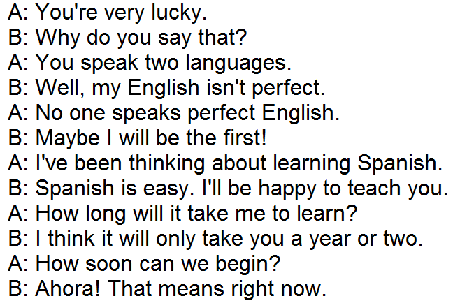
Read and listen to next dialogue and then re-write it in third person:
http://www.eslfast.com/easydialogs/ec/dailylife067.htm
He is very lucky
él tiene mucha suerte

Slide 3

Go to http://www.ehow.com/how_4641_know-someone-likes.html and with your own words try to describe the most important aspects in each number, related to behavior and body language.
 | Behavior
1 | That person likes to talk to you frequently
2
3
4
5
6
7
 | Body language
1
2
3
4
5
6

