Slide 1
Level 2
Student’s name:

Slide 2
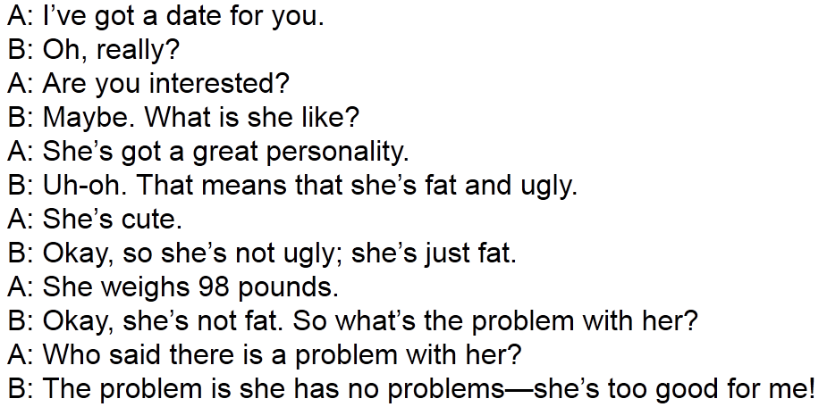
Go to http://www.eslfast.com/easydialogs/ec/dating01.htm listen to and read the dialogue, then deduce 5 sentences in third person:
The man is interested in the date
el hombre está interesado en la cita

Slide 3


Watch and listen to next dialogue, then answer.
http://www.eslfast.com/easydialogs/ec/dating04.htm
Is it possible to fall in love at first sight? What do you think?
Give large answers
I think one can fall in love ay first sight………
I believe it’s not possible to fall in love at first……..

Slide 4
Go to http://www.eslfast.com/easydialogs/ec/dating10.htm read and listen to the dialogue, then re-write the history in order that in can change the title for “the best date”.
Change the actions, places… and make it a really nice date.
 | The best date
A
B
A
B
A
B
A
B
A
B
A
B
A
B

