Slide 1
Level 3
Student’s name

Slide 2
After reading and studying the conditional one, complete next sentences by using the future “will” and send the pronunciation.
1. if I win the lottery, (Si yo me gano la lotería)
2. if I see a Martian, (Si yo veo un marciano)
3. if my computer doesn’t turn on, (Si mi computador no enciende)
4. If my best friend says me “I love you”, (Si mi mejor amigo(a) me dice: “te amo”)
5. if my graduation ceremony is tomorrow, (Si mi fiesta de graduación es mañana)
6. if I see my father/mother in trouble, (Si yo veo a mi padre/madre en problemas)
7. If I can ask God for a wish, (Si yo puedo pedirle a Dios un deseo)
8. If I am ten years younger, (Si yo soy 10 años más joven)
9. if I have just one week for living, (Si sólo me queda una semana de vida)
10. if I cheat on my activities or exams, (Si yo hago fraude en mis actividades o exámenes)

Slide 3
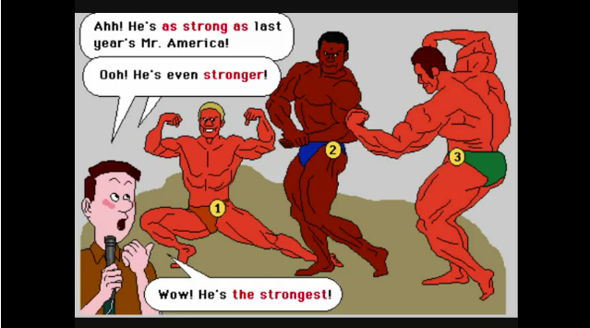
From next video, identify the sentences in superlative form after reading the examples:
http://www.youtube.com/watch?v=ND6VNHCFd_Q&NR=1

Slide 4
Write and pronounce 5 conditional sentences, beginning with IF, then a sentence in future tense, according to real situations.
 | IF sentences + future “Will” If I don’t send my activities, I won’t have good grades
1.
2.
3.
4.
5.

