Slide 1
Level 2
Student’s name:

Slide 2
I’ll get used to relaxing! I used to sleep late – when I was a young boy I used to stay in bed until noon. On Saturday, my brother and I used to play baseball with our friends and eat hot dogs. I got used to working – when I grew up I started my own business and got used to working very hard ,ten hours a day , six days a week. I’ll get used to retirement!- soon it will come a time when I’ll get used to relaxing . I will get used to waking up early and going fishing by the lake. I’ll be used to sitting down on the porch and seeing how my son takes care of the business.
READING COMPREHENSION
What did he do when he was a boy? | ¿Qué hacía él cuando era un niño?
When he was a boy he used to stay in bed | Cuando él era un niño solía quedarse en la cama
When did he play with his brother? | ¿Cuándo jugaba él con su hermano?
He played with his brother on Saturdays | Él jugaba con su hermano los sábados.
How often did he get use to working hard? | ¿Con qué frecuencia él se acostumbró a trabajar duro?
He got used to working hard six days a week | Él se acostumbró a trabajar duro seis días a la semana
How did he work? | ¿Cómo trabajaba él?
He worked very hard | Él trabajaba muy fuerte

Slide 3
Describe your experiences and plans by using:
Large sentences
Used to
Get used to
Be used to

Slide 4
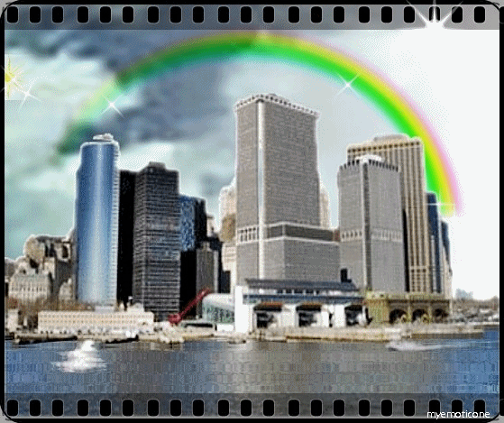
Write 10 sentences using the superlative form, according to the examples and explanations. Use short, large and irregular adjectives.
Pineapple is one of the most delicious fruits
La piña es una de las frutas más deliciosas
New York is one of the biggest cities
Nueva York es una de las ciudades más grandes

Slide 5
From next reading, deduce 5 superlative sentences:
Colombia is a country of South America. It is located at the North-West part of that Continent and it has an area of 1.141.748 km² (440,839 square miles). It is the only South American country with coasts in both Oceans (Pacific and Atlantic). Colombia has an extension of 928.660 km² in those oceans. The name "Colombia" is different from “Columbia”, the name of many places in North America. Almost 43 million people live in Colombia and it is the third most populated country of Latin America after Mexico and Brazil. The capital of Colombia is Bogotá. The second major city is Medellin and it is also a big industrial center. The third largest city is Cali, home of many multinational companies. The most important city of the country on the Caribbean coast is Barranquilla. Cartagena is great touristic city too. Colombia is known for its coffee, coal, and emeralds. There are a few armed conflicts in Colombia. Most rebel groups finance their operations with the trade of illegal drugs.

