Slide 1
Life in a future

Slide 2

“I wonder how our world will be like in another fifty years. Can you imagine what it would be like living then? Flying cars, fusion power, maybe even a time machine will be invented by then.”
Mention three innovative technologies you believe will exist in another 50 years (2061) and tell what it will/is going to be used for/used to. Example:
The tele-transportation machine | It will be used for going from place to place instantly.
The antigravity engine | It is going to be used to float and levitate things.

Slide 3
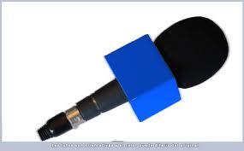
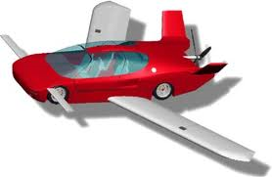
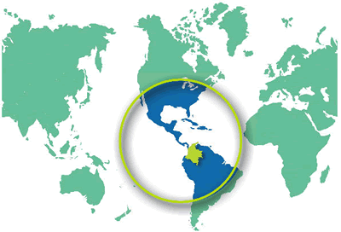
Write and pronounce life in a future, using superlatives (a short text), example:
Flying cars will be the most used means of transport around the world and
Colombia will be the most peaceful country.

