Slide 1
Game
Pronuncation
Superlative

Slide 2

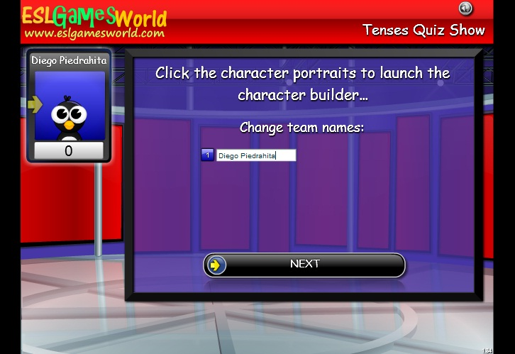
Go to next link, play the game, write your name and last name, be sure of the meaning in Spanish to know which option to choose, when the score is up to 3000 send an image of the result.
Choose the number of team: 1
http://www.eslgamesworld.com/members/games/ClassroomGames/Quizshow/Verb%20Tenses%20Past,%20Future,%20Perfect%20Present/index.html

Slide 3

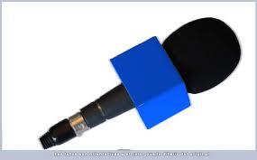

Send your pronunciation of the short story “he will work for gas”
http://www.rong-chang.com/nse/se/nse080.htm
Using your own words, write 5 sentences in which you describe what happened in the short story in chronological order. Example:
1. Doug was looking for a job.

Slide 4

Describe some of the appliances of the digital revolution, using the next adjectives in superlative form. (Use your own words), example:
Internet is the most important invention
Expensive | Bad
Important | Innovative
Useful | Dangerous
Good | Cheap

