Slide 1
Level 3
Student’s name:

Slide 2

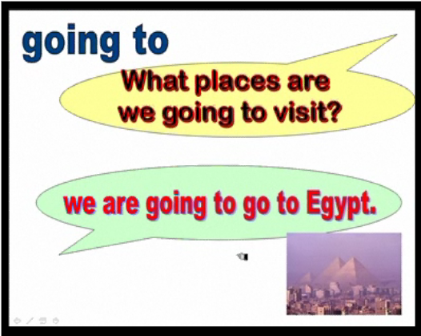
Go to http://www.englishmedialab.com/higherlevels/travel%20plans/travel%20plans.html and make a similar description of your future plans, and send the pronunciation

Slide 3


According to 5 real situations, use “I’m afraid” to describe possible actions to happen in your environment, as a result of a previous sentence in present. Send your pronunciation:
I like English very much:
I’m afraid I’m going to pass the English course.
Colombian National Soccer Team is playing really well
I’m afraid it’s going to win the next World Soccer Cup

