Slide 1
Level 2
Student’s name:

Slide 2
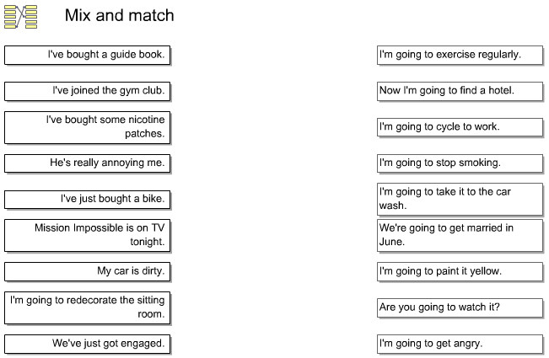
Go to http://www.englishgrammarsecrets.com/goingtofuture/menu.php read the explanations of GOING TO and make one of the exercises 1, 2, 3 or 4, then write the result:
Example: exercise 1 you have to complete sentences 1 with one of the sentences B

Slide 3


Answer according to you reality.
Give large answers
An interview
A: Where are you going to live next year? | ¿Dónde va a vivir usted el próximo año?
B: Next year …
A: What are you going to be in a future? | ¿Qué va a ser usted en un futuro?
B: In a future …
A: Where are you going to study next year? | ¿Dónde va a estudiar usted el próximo año?
B: Next year …
A: When is your graduation ceremony going to be? | ¿Cuándo va a ser su graduación?
B: My graduation …
A: How is your life going to be in a future? B: my life . .. | ¿Cómo va a ser su vida en un futuro?

Slide 4

Paste 5 images and use I’M AFRAID to describe possible situations to happen
 | I’m afraid they are going to marry Me temo que ellos se van a casar

