Slide 1
Level 2
Student’s name:

Slide 2
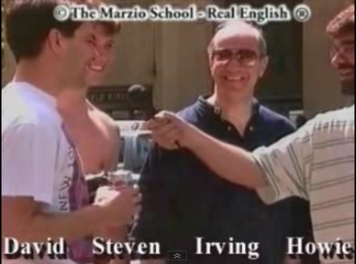
Go to http://www.youtube.com/watch?v=pccL9huEbkc watch the video and deduce 10 situations (in third person: he, she, it) :
Susan is not married - Susan no es casada
David and Steven aren’t engaged - David y Steven no tienen compromisos

Slide 3
CONJUNCTIONS: they are used to connect two words, sentences or phrases
 | SPANISH | EXAMPLE
Because | Porque, ya que | Because he was sleepy, he went to bed (ya que él tenía suelo, se acostó) He went to bed because he was sleepy (él se acostó porque tenía sueño)
 | SPANISH | EXAMPLE
Because | Ya que | Because the weather was cold, we stayed home (ya que el tiempo estaba frío, nos quedamos en casa)
Because of | A causa de | Because of the cold weather, we stayed home (a causa del tiempo frío, nos quedamos en casa)
Due to | Debido a | Due to the cold weather, we stayed home (debido al tiempo frío, nos quedamos en casa)
NOTA: | Because + subject and verb Because of and due to + a noun object
Cause and effect
 | SPANISH | EXAMPLE
While | Mientras | Mary is rich, while John is poor (Mary es rica, mientras que John es pobre)
But | Pero | John is poor, but Mary is rich (John es pobre, pero Mary es rica)
However | Sin embargo | John is poor, however Mary is rich (John es pobre, sin embargo Mary es rica)
Opposition

Slide 4
ACTIVITY: Make a sentence according to your reality using the connectors:
CONNECTORS | SENTENCE
Because
Because of
Due to
While
But
However
Remember not to use web translators

Slide 5
According to the reading: Very good friends: North and South”, identify the answers for the next questions.
When did they buy a car? |  | They went together to church
Who are good friends? |  | Yes, they do
Do they like each other very much? |  | Yes, it was
Are they still good friends? |  | Walter and Linda
Where do Walter and Linda live? |  | Yes, they are
Does Walter live in Minnesota? |  | Last year
Was the plant for Walter and Linda? |  | No, he doesn’t
Where did they go together? |  | They live in Alabama

