Slide 1
Level 2
Student’s name:

Slide 2
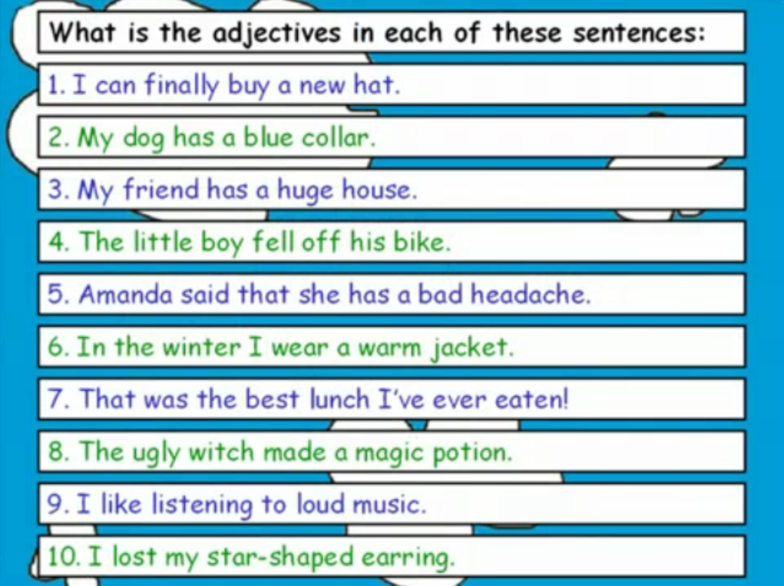
Watch this video http://www.youtube.com/watch?v=HMGFxmt986c identify the use and position of adjectives, then identify the adjective in each of the 10 sentences and complete with your own one.

Slide 3
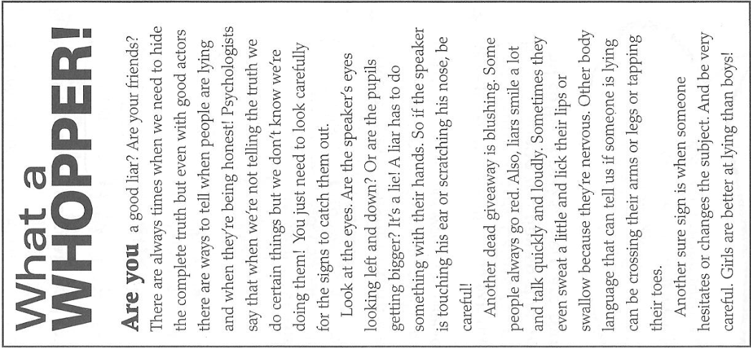

:

Slide 4
Complete the collocations in these sentences with words from the article.
1. You can tell from her body_______________ that she does not really like him.
2. Don’t change the__________. It is important to talk about this.
3. I know she is not keeping to her diet. There is a chocolate wrapper in her bag. It is a dead_____________!
4. I am going shopping instead of going to school. I hope my mum does not__________ me out and see me.
5. We have to keep our classroom neat and tidy this week. It is a sure sign we are having an inspection!

