Slide 1
Future tense
Clothing
Present tense

Slide 2
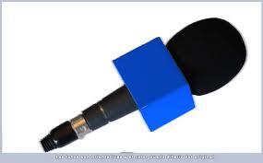
Describe your next vacations including answers for the next questions: (send the pronunciation)
where will you go on vacation?
Which season?
Which clothing will you wear?
What will you do?
Example:
On vacation, in summer, I will go to Santa Marta, I will travel with my parents. We will use shorts and t-shirts, sandals and hats.
The days will be very hot, so, we will take sunglasses, too.
We will visit the beautiful places that there are in that city. We will go to the beach and will take photos from every place…..

Slide 3
What will be on fashion for next year/generation? Send the pronunciation
MAN
FORMAL | CASUAL
Tuxedo, black and leather shoes….
WOMEN
FORMAL | CASUAL

Slide 4
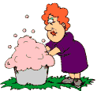
Describe what a family member does at home, in simple present tense, using “daily verbs” send the pronunciation
My mother:
She wakes up at 6:00 am, then she takes a shower.
She cooks breakfast for my brothers, later she makes the beds and cleans the house.
In the afternoon she watches TV…

