Slide 1
Descriptions
Clothing
Seasons

Slide 2
Describe yourself by using adjectives, verb to have and possessive adjectives.
MY PHOTO | MY DESCRIPTION
WHAT ARE YOU LIKE?
 | I’m young, Thin, Athletic and average height. My hair is short and dark. I am warm, absent-minded, vain and selfish. I like soccer, my favorite sport. I’m hard-working and nice. | Yo soy joven, Delgado, atlético y de estatura media. Mi cabello es corto y negro. Soy afectuoso, vanidoso y egoísta. Me gusta el fútbol, mi deporte favorito. Soy trabajador y simpático.

Slide 3

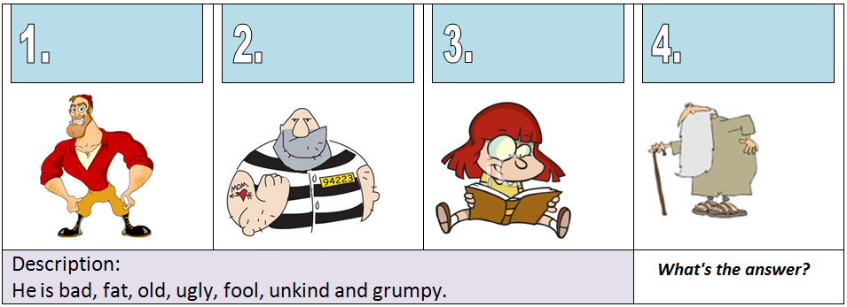
Identify the best description
Answer: N°

Slide 4

Paste an image and describe the clothing, similar to next examples:
http://www.englishmedialab.com/elementaryvideos/clothes%20describing/clothes%20describing.html
IMAGE | DESCRIPTION
 | What is he/she wearing?

Slide 5

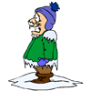
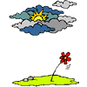
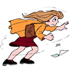
Which clothing do you use in each season and what do you do?
WEATHER | Sunny | Freezing | Cloudy | Windy
ACTION/VERB
CLOTHING

