Slide 1
GAME
Present continuous tense

Slide 2

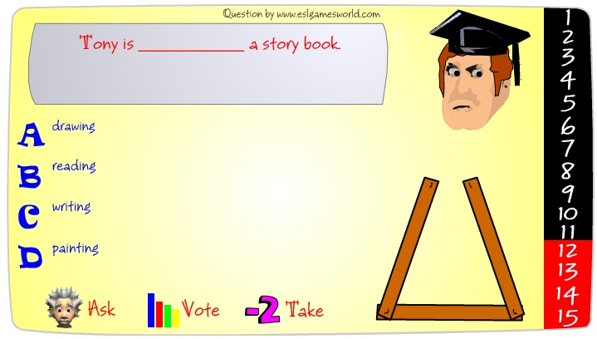
Activity. Go to next link to play a game, make sure to use the correct verb in present continuous tense, and when the 15 sentences are correct, send the image of the CONGRATULATIONS.
http://www.englishmedialab.com/GrammarGames/fling%20the%20teacher/actionverbs/present%20progressive%20multiple%20choice.html
PLAY + CONTINUE
This is an example of the process

Slide 3

Activity. Go to http://www.rong-chang.com/nse/se/nse054.htm listen to the short story as much as necessary, and send your pronunciation.
Ruth is pregnant. She is expecting a baby. The baby is due in two months. The baby is a boy. It is her first boy. She already has a little girl. Her little girl is two years old. Ruth loves her little girl. Her little girl is happy to get a baby brother. Ruth is eating for two people right now. She is very careful about what she eats and drinks. She eats a lot of fresh fruits and vegetables. She eats fresh fish twice a week. She doesn't drink alcohol or coffee. She doesn't eat candy or potato chips. She stays away from cigarette smokers. She will have a healthy baby.
Activity. Complete according to the last reading.
Main idea:
Key words: | baby

Slide 4

Activity. Look at these videos of celebrations in Colombia and complete the data http://en.wikipedia.org/wiki/Carnival_in_Colombia
Celebrations | Where? | When?
Flower fair
The Yipao
Blacks and Whites' Carnival
Bambuco Pageant and Folkloric Festival
Rock al Parque

