Slide 1

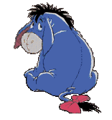

DESCRIPTION – WHAT IS IT LIKE?
WANTED
DEAD OR ALIVE
DESCRIPTION: it is a donkey. It is blue, lazy, tactless, unkind, fat and absent-minded. Its eyes are big and its tail is long.
NICKNAME: Igor
CRIME: it escaped from the zoo.
RECOMPENSE: One hundred dollars

