Slide 1
Story: the dog and his bone
The past continuous tense
There was and there were

Slide 2

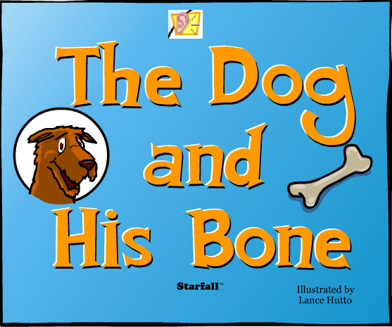
Go to http://www.starfall.com/n/comics/dog-and-bone/load.htm?f read and listen to the story, then complete next images according to the text by using your own words in past (was, were) or there was and there were.
Click here to listen to the pronunciation

Slide 3

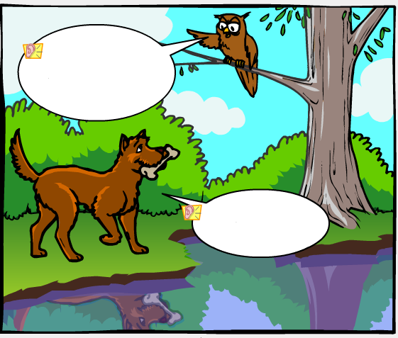
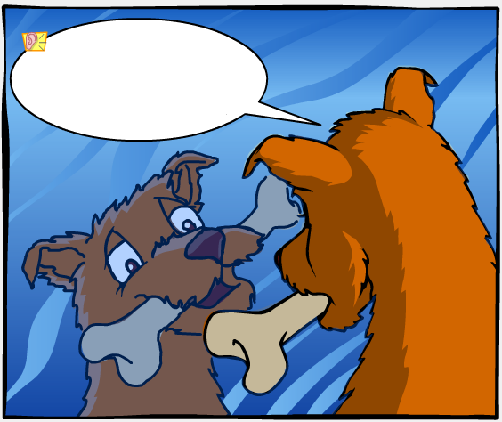
Complete the blanks with sentences in past continuous, using your own words to describe what you read from the original story.

Slide 4
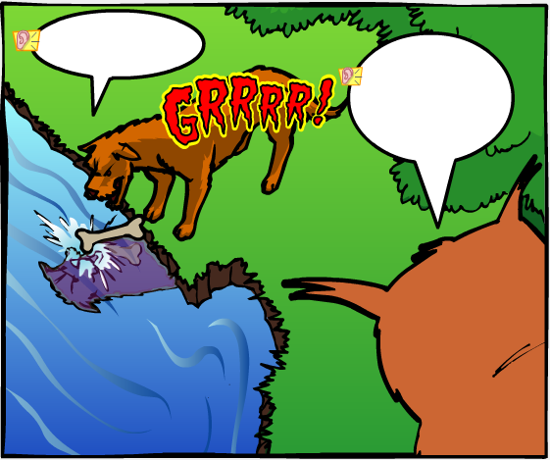
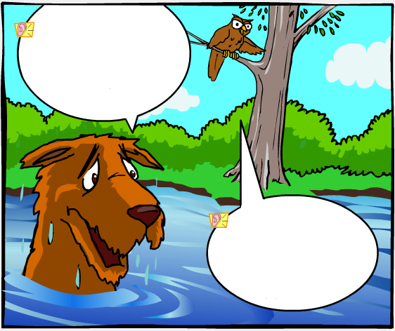
Use your own words to describe the image from the original story (in past continuous tense: was/ were + ing, or, there was, there were.

Slide 5
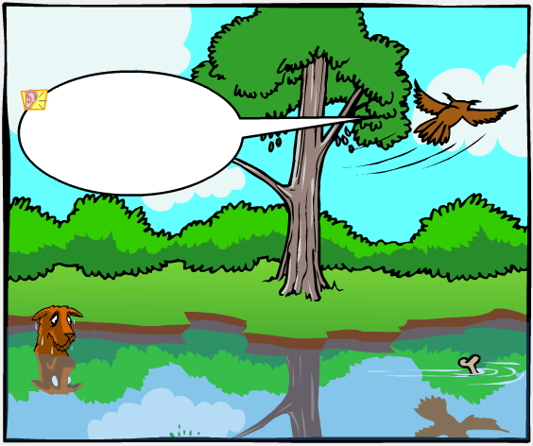
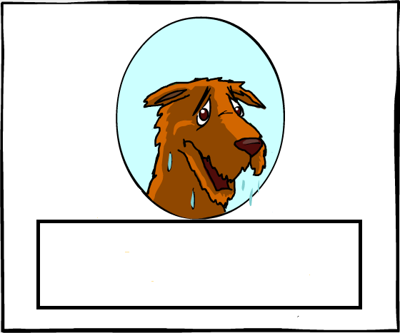
Complete the blank with a sentence in past, using was or were, and finally give a conclusion changing “it was a bad idea” for your own sentence.
It was a bad idea!

Slide 6

Use THERE WAS and THERE WERE to describe the 7 images (pages).
DESCRIBING IMAGES: THERE WAS (NOT)- THERE WERE (NOT)
1 | There were two animals: a dog and an owl.
2
3
4
5
6
7

