Slide 1
Likes and dislikes
Descriptions: there is and there are

Slide 2

Activity. Write and pronounce what you like and dislike, using verbs, food, sports, etc.
I like | I hate | I enjoy
Soccer | Basketball | Pizza
Go to:
Fruits: http://www.languageguide.org/english/vocabulary/fruit/
Food: http://www.languageguide.org/english/vocabulary/food/
http://www.languageguide.org/english/vocabulary/food2/
Animals: http://www.languageguide.org/english/vocabulary/farm-animals/

Slide 3
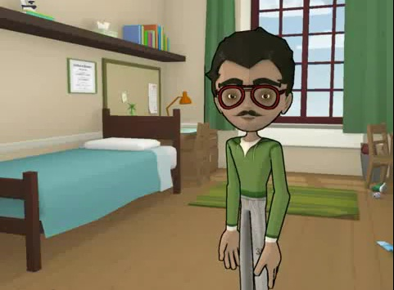
Activity. Paste an image and describe it using there is, there are, nouns in singular, plural, etc.
Example: http://www.youtube.com/watch?v=M03SoVrr-nA&feature=related
There is 1 window. There are 7 books. There isn’t a TV

