Slide 1
Level 3
Student’s name:

Slide 2
From next video identify the different occupations and then describe what your relatives do:
http://www.youtube.com/watch?v=LZbD4-usGm0&feature=related
Who? | Occupation? | What? | Where?
My mother | Teacher | Teach Spanish | In the school

Slide 3
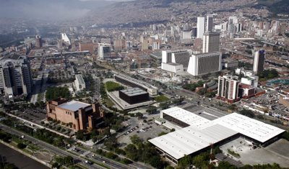
Paste an image of a city and describe its places, or the city you live in:
Send your pronunciation
Tomado de http://medellin-colombia.blogspot.com/2009/04/travel-guide-map-of-medellin-colombia.html
The stadium is near the metro station
The park is behind the hospital
The university is between the river and the teather

