Slide 1
Level 3
Student’s name:

Slide 2
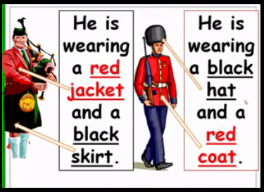
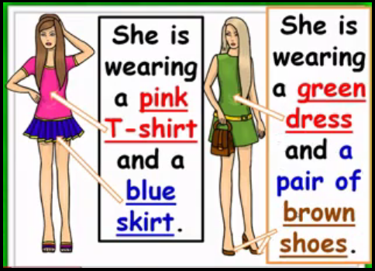
Paste 2 images and describe the clothing he/she is wearing. Send the pronunciation
http://www.youtube.com/watch?v=j62HR5lNpzw

Slide 3
DESCRIBING CLOTHES 1
He/she is wearing
DESCRIPTION
IMAGE

Slide 4
DESCRIBING CLOTHES 2
He/she is wearing
DESCRIPTION
IMAGE

Slide 5
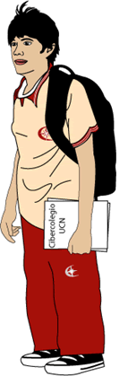
Complete with your personal information and sent the pronunciation. .
Name Last name Age Birthday Place of birth Telephone number Nationality Marital status Hobby Favorite music Occupation Sex | _________________________________ ________________________ _________________________ _______________________________________ _______________________________________ _______________________________________ _______________________________________ _______________________________________ _______________________________________ _______________________________________ _______________________________________ ­_______________________________________
PHOTO

Slide 6
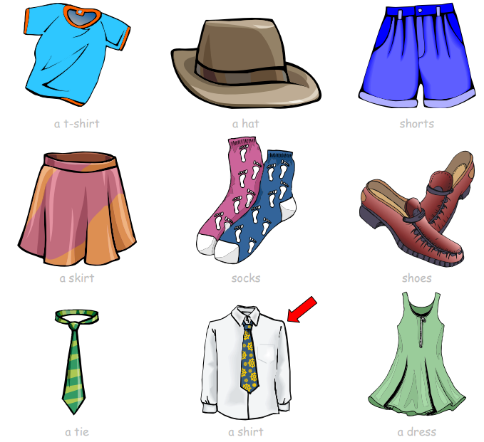
Ressources: Vocabulary
http://www.mes-english.com/flashcards/files/clothes.pdf:

Slide 7
