Slide 1
Level 2
Student’s name:

Slide 2
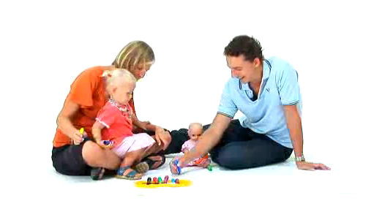
Write the members of the family and sentences that you see on the video, then translate into Spanish.
http://www.youtube.com/watch?v=PCl2mKzxCCs
English - Spanish
Who lives in your house? | ¿Quién vive en su casa?
How big is your family | ¿Qué tan grande es su familia?
Aunt | Tía
uncle | Tío

Slide 3
Use the next adjectives to describe yourself and 4 members of your family:
PHYSICAL |  | PERSONALITY
ENGLISH | SPANISH | ENGLISH | SPANISH
Fat | gordo | Hard-working | trabajador
Thin | delgado | Lazy | perezoso
Slim | esbelto | Sensible | sensato
Tall | alto | Fool | insensato
Short | bajo | Nice | simpático
Small | pequeño | Unpleasant | antipático
Average height | de estatura media | careless | descuidado
Average build | de complexión media | Absent-minded | despistado
Athletic | atlético | Sensitive | sensible
Weak | débil | Unkind | cruel
Attractive | atractivo | Generous | generoso
Ugly | feo | Selfish | egoísta
Pretty | bonita | Modest | modesto
Beautiful | hermoso | Vain | vanidoso
Good-looking | bien parecido - atractivo | Warm | afectuoso
Young | joven | Tactful | discreto
Old | viejo | Tactless | indiscreto
 |  | Friendly | amigable
 |  | Grumpy | malhumorado

Slide 4
 | Family member |  | Adjectives
Example
My mother is small, young, generous, beautiful, friendly, sensitive, absent-minded and hardworking
My |  | Is
My |  | Is
My |  | Is
My |  | Is
I am . . .

