Slide 1
COUNTRIES AND NATIONALITIES

Slide 2

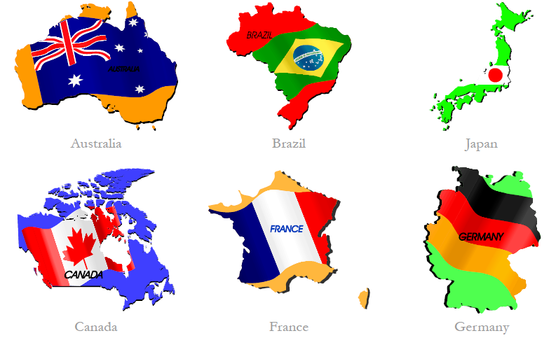
I am from . . .

Slide 3
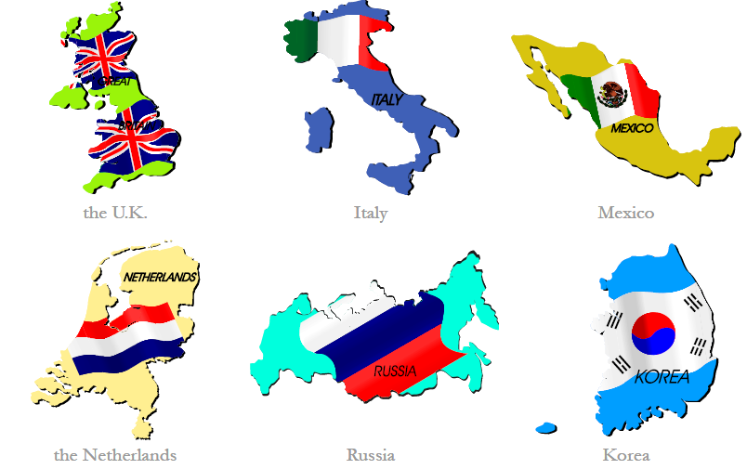
I am from . . .

Slide 4
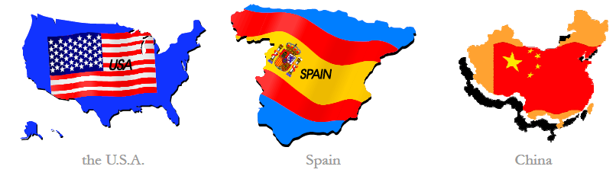
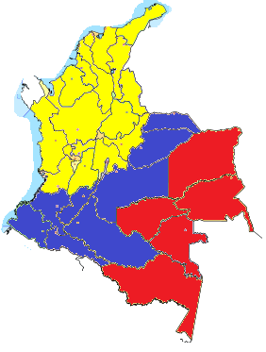
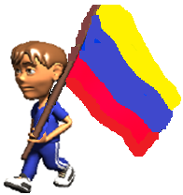
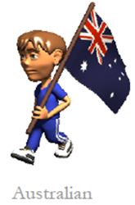
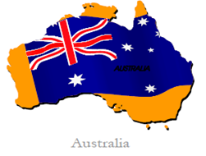
I am from . . .
I am . . .
Colombia
Colombian

Slide 5
Pronunciation File | Country | Language | Nationality
One syllable | France | French | French
 | Greece | Greek | Greek
ends in '-ish' | Britain | English | British
 | Denmark | Danish | Danish
 | Finland | Finnish | Finnish
 | Poland | Polish | Polish
 | Spain | Spanish | Spanish
 | Sweden | Swedish | Swedish
 | Turkey | Turkish | Turkish
ends in '-an' | Germany | German | German
 | Mexico | Spanish | Mexican
 | The United States | English | American
ends in '-ian' or '-ean' | Australia | English | Australian
 | Brazil | Portuguese | Brazilian
 | Egypt | Arabic | Egyptian
 | Italy | Italian | Italian
 | Hungary | Hungarian | Hungarian
 | Korea | Korean | Korean
 | Russia | Russian | Russian
ends in '-ese' | China | Chinese | Chinese
 | Japan | Japanese | Japanese
 | Portugal | Portuguese | Portuguese

