Slide 1
- Flags and their colors
- The time

Slide 2

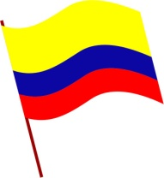
Activity 8. paste 5 flags, and complete with country, language and color. Pronounce each sentence
FLAG | COUNTRY | LANGUAGE | COLOR
 | Colombia | Spanish | Yellow, blue and red

