Slide 1
My calendar

Slide 2
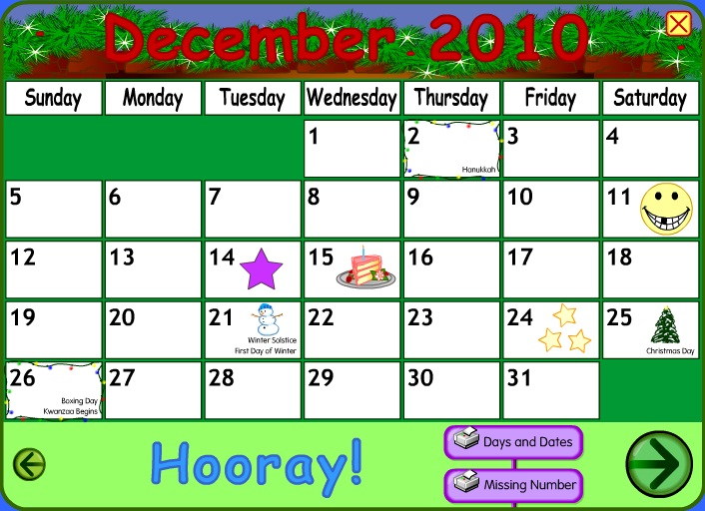
Activity 6. go to: http://www.starfall.com/n/holiday/calendar/load.htm?f&n=main follow the instructions, and finally make a screen of your calendar (copy) and paste it here.

