Slide 1
Figures of speech
By
Diego Piedrahíta
Cibercolegio UCN
2011

Slide 2
Figures of speech
A figure of speech is a rhetorical device that achieves a special effect by using words in distinctive ways
We use figures of speech every day in our own writing and conversations.
It is a use of a word that diverges from its normal meaning, or a phrase with a specialized meaning.

Slide 3
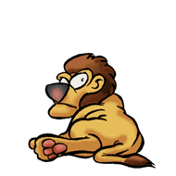
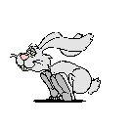
Alliteration:
Laughing Lions
Laughing lions laugh
like jumping jaguars
on top of talking trees.
When the talking trees start talking,
the joking jaguars fall off.
"a peck of pickled peppers.“
"Rabbits running over roses"
Definition:
- Series of words that begin with the same consonant or sound alike
- When two or more words in a poem begin with the same letter or sound.
Adjective: alliterative.

Slide 4
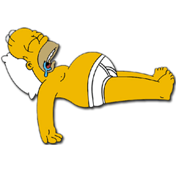
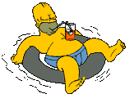
Anaphora
"I needed a drink, I needed a lot of life insurance, I needed a vacation, I needed a home in the country. What I had was a coat, a hat and a gun.“
"When I was a child, I spoke as a child, I understood as a child, I thought as child."
Definition:
Repetition of the same word or group of words at the beginning of successive clauses, sentences, or lines.
Epiphora / Epistrophe
"I'm a Pepper, he's a Pepper, she's a Pepper, we're a Pepper. Wouldn't you like to be a Pepper, too? Dr. Pepper."
Adjective: anaphoric.

Slide 5
Metaphors
The words were music to his ears.
Sweet
“She's the apple of my eye”
Center of attention / appreciation
“That wet blanket is a loose cannon.”
Something or somebody liable to cause damage
A dull person who spoils other people’s enjoyment
"falling in love," "racking our brains,“ and "climbing the ladder of success”
Definition:
An implied comparison between two unlike things that actually have something important in common.
Adjective: metaphoric.

Slide 6
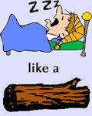
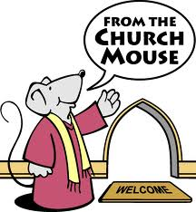
Simile
"Good coffee is like friendship: rich and warm and strong”.
"Life is rather like a tin of sardines: we're all of us looking for the key."
"She dealt with moral problems as a cleaver deals with meat.”
“Playing the piano is like a bird soaring in the sky.”
As poor as a church mouse
Definition:
A figure of speech in which two fundamentally unlike things are explicitly compared, usually in a phrase introduced by like or as.

Slide 7

Antithesis
Man proposes, God disposes.
Give everyman thy ear, but few thy voice.
“We must learn to live together as brothers or perish together as fools."
Many are called, but few are chosen.
"To err is human, to forgive, divine."
"One small step for a man, one giant leap for all mankind."
Definition:
A rhetorical term for the juxtaposition of contrasting ideas in balanced phrases or clauses
Adjective: antithetical.

Slide 8
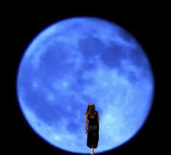
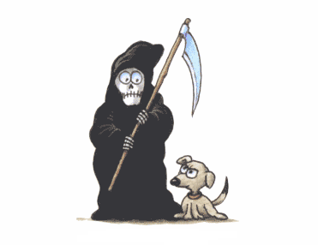
Apostrophe
“Hello darkness, my old friend
I've come to talk with you again . . . .”
"Blue Moon, you saw me standing alone
Without a dream in my heart
Without a love of my own."
"Then come, sweet death, and rid me of this grief."
vocative
"Oh, Death, be not proud."
Definition:
A figure of speech in which some absent or nonexistent person or thing is addressed as if present and capable of understanding.

Slide 9
Chiasmus
"The value of marriage is not that adults produce children, . . .
"Nice to see you, to see you, nice!“
but that children produce adults."
"Never let a fool kiss you . . .
"Fair is foul, and foul is fair."
or a kiss fool you."
"Do I love you because you're beautiful?
Or are you beautiful because I love you?"
"My job is not to represent Washington to you, . . .
,but to represent you to Washington."
"You forget what you want to remember, and you remember what you want to forget.”
"If black men have no rights in the eyes of the white men, of course the whites can have none in the eyes of the blacks."
Definition:
A verbal pattern (a type of antithesis) in which the second half of an expression is balanced against the first with the parts reversed.
Two or more clauses are related to each other through a reversal of structures in order to make a larger point

Slide 10
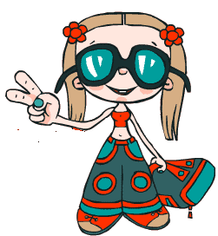
Paradox
“War is peace."
"Freedom is slavery."
"Ignorance is strength."
"Some day you will be old enough to start reading fairy tales again."
For there to be peace there must first be war
You can save money by spending it.
"I have found the paradox, that if you love until it hurts, there can be no more hurt, only more love."
Definition:
A statement that appears to contradict itself.
It's a logical process, in which the facts appear to be opposed to themselves
Adjective: paradoxical

Slide 11
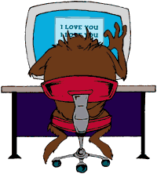
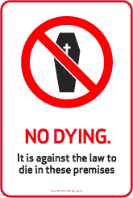
Euphemism
 | DIALOGUE
Dan Foreman: | Guys, I feel very terrible about what I'm about to say. But I'm afraid you're both being let go.
Lou: | Let go? What does that mean?
Dan Foreman: | : It means you're being fired, Louie
Adult entertainment
Pornography
Kick the bucket
Pass away
Definition:
The substitution of an inoffensive term (such as "passed away") for one considered offensively explicit ("died“)

Slide 12
Match
An escort service
a sanitation engineer
vertically challenged
Call of nature
Disabled
Batting for the other side
Lose your lunch
Comfort women
Bun in the oven
Armed intervention
Full bodied
Preowned
Get it on
A short person
Having sexual intercourse with
War
Used or second hand
Pregnant
Obese
Prostitution ring
A garbage collector
Prostitute
The urge to urinate or defecate
Vomit
Handicapped
Homosexual
Prostitution ring
A garbage collector
A small person
The urge to urinate or defecate
Handicapped
Homosexual
Vomit
Prostitute
Pregnant
War
Obese
Used or second hand
Have sexual intercourse with

Slide 13
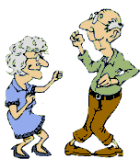
Hyperbole
Your mama's hair is so short she could stand on her head and her hair wouldn't touch the ground. . . .
Your father is so low he has to look up to tie his shoes.
You're so low down you need an umbrella to protect yourself from ant piss.
My grandmother is so old that she personally knew Shakespeare!"
My aunt is son fat that every time she turns around it's her birthday.
Definition:
An extravagant statement; the use of exaggerated terms for the purpose of emphasis or heightened effect.

Slide 14
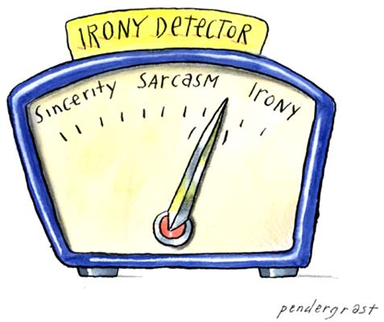
Irony
"Gentlemen, you can't fight in here! This is the War Room”
"Math was my worst subject because I could never persuade the teacher that my answers were meant ironically."
Woman: I started riding these trains in the forties. Those days a man would give up his seat for a woman. Now we're liberated and we have to stand.
Elaine: It's ironic.
Woman: What's ironic?
Elaine: This, that we've come all this way, we have made all this progress, but you know we've lost the little things, the niceties.
Woman: No, I mean what does ironic mean?
Elaine: Oh.
Definition:
The use of words to convey the opposite of their literal meaning. A statement or situation where the meaning is contradicted by the appearance or presentation of the idea.
Adjective: ironical

Slide 15
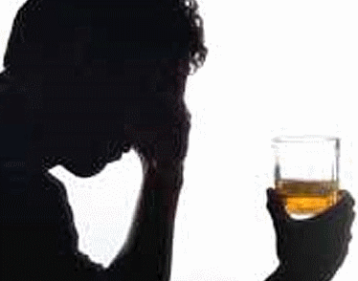
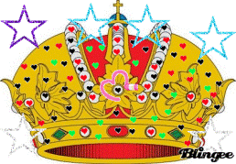
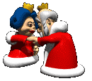
Metonymy
A figure of speech in which one word or phrase is substituted for another with which it is closely associated; also, the rhetorical strategy of describing something indirectly by referring to things around it.
"I stopped at a bar and had a couple of double Scotches. They didn't do me any good. All they did was make me think of Silver Wig, and I never saw her again."
Crown for Royalty
The White House asked the television networks for air time on Monday night
"The House was called to order," meaning the members in the House.
Definition:
It is a rhetorical strategy of describing something indirectly by referring to things around it, such as describing someone's clothing to characterize the individual

Slide 16
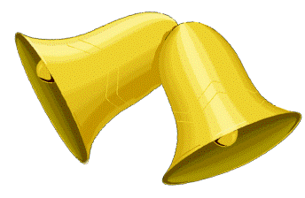
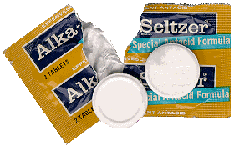
Onomatopoeia
"I'm getting married in the morning!
Ding dong! the bells are gonna chime."
"It went zip when it moved and bop when it stopped,
And whirr when it stood still.
I never knew just what it was and I guess I never will."
"Plop, plop, fizz, fizz, oh what a relief it is."
(slogan of Alka Seltzer, U.S.)
"Onomatopoeia every time I see ya
My senses tell me hubba
And I just can't disagree.
I get a feeling in my heart that I can't describe. . . .
"Bang! went the pistol,
Crash! went the window
Ouch! went the son of a gun.
Definition:
The use of words that imitate the sounds associated with the objects or actions they refer to.

Slide 17
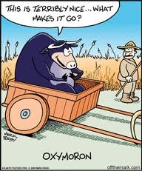
Oxymoron
"We have to believe in free will. We have no choice."
(Isaac Bashevis Singer)
"Health food makes me sick."
(Calvin Trillin)
"I hate intolerant people."
(Gloria Steinem)
"The best cure for insomnia is to get a lot of sleep."
(W.C. Fields)
"How is it possible to have a civil war?"
(George Carlin)
Always remember you're unique...just like everyone else!
Definition:
A figure of speech in which incongruous or contradictory terms appear side by side.

Slide 18

Personification
The wind stood up and gave a shout.
He whistled on his fingers and
Kicked the withered leaves about
And thumped the branches with his hand
And said he'd kill and kill and kill,
And so he will and so he will.
(James Stephens, "The Wind")
The sun greeted me this morning.
"The only monster here is the gambling monster that has enslaved your mother! I call him Gamblor, and it's time to snatch your mother from his neon claws!"
(Homer Simpson, The Simpsons)
"Fear knocked on the door. Faith answered. There was no one there."
(proverb quoted by Christopher Moltisanti, The Sopranos)
"Oreo: Milk’s favorite cookie.“
Definition:
A figure of speech in which an inanimate object or abstraction is endowed with human qualities or abilities

Slide 19
Synecdoche
"Take thy face hence.“
(William Shakespeare, Macbeth)
"head" for cattle
"white hair" for the elderly
"coke" for soda
"mouths to feed" for hungry people
body
Give us this day our daily bread.
food
In the 2010 Winter Olympics, Canada won 14 gold medals.
National team
All hands on deck.
Workers
Definition:
A figure of speech in which a part is used to represent the whole (for example, ABCs for alphabet) or the whole for a part ("England won the World Cup in 1966").
A part of something is used for the whole,
The whole is used for a part,
The species is used for the genus,
The genus is used for the species

Slide 20

Cibercolegio UCN
2011

