Slide 1
MY LIFE: BIOGRAPHY
HOW TO . . .
THE IMPERATIVE FORM
PRONUNCIATION

Slide 2
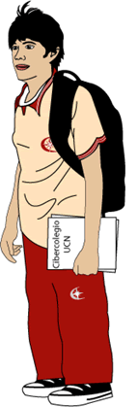
Read next biography, then write your own using the present perfect tense
MY LIFE
 | I have been a good student. I have studied in different schools, and Ciberschool has been a very nice experience. I have lived in a big city with my parents; they have lived happily married for 35 years. I have one brother and one sister. My brother has been a teacher and my sister has worked as a secretary. I haven’t married because I haven’t had the opportunity to have a good job, but I’m studying to be an excellent professional. My life has been pleasant because I have had a great family and wonderful friends. They have taught me how to enjoy every day.

Slide 3
Write and pronounce your biography, and paste an image (it can be your photo)
TITLE
 | I have . . .

Slide 4

Make a text giving orders, commands, directions, instructions or requesting, giving advice, suggesting, warning or inviting someone to do something. You can make a recipe or a text related to something you know very well how to do.
Send your pronunciation
HOW TO STUDY BY INTERNET
First buy a computer, take it home and try it. Turn on the PC, make sure it is on the internet, then use the keyboard and the mouse , after that let’s go to google…

