Slide 1
Pronunciation
Real actions by using figures of speech

Slide 2

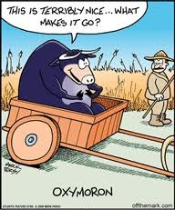
Invent two sentences for each figure, and send the pronunciation.
Be as creative as possible, use images, dialogues, express experiences, etc.
Euphemism
Chiasmus
Metonymy
Personification
Synecdoche

