Slide 1
Game
Pronunciation
Reading comprehension
Hyperboles

Slide 2

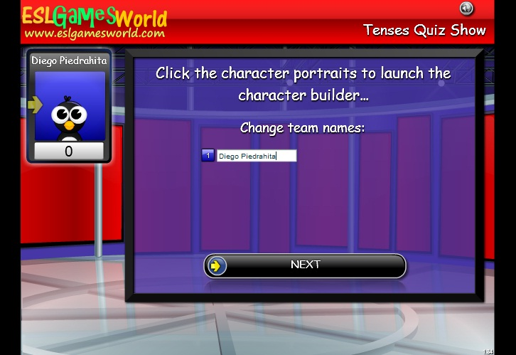
Go to next link, play the game, write your name and last name, be sure of the meaning in Spanish to know which option to choose, when the score is up to 3000 send an image of the result.
Choose the number of team: 1
http://www.eslgamesworld.com/members/games/ClassroomGames/Quizshow/Verb%20Tenses%20Past,%20Future,%20Perfect%20Present/index.html

Slide 3

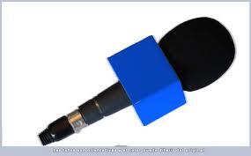
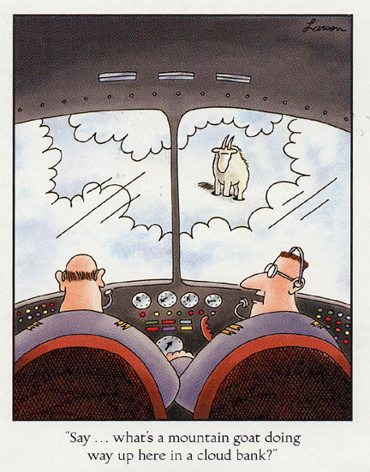
Send your pronunciation of the short story “they took a nap”
http://www.rong-chang.com/nse/se/nse097.htm
Using your own words, write 5 sentences in which you describe what happened in last short story in chronological order. Example:
1. The pilots began their trip

Slide 4
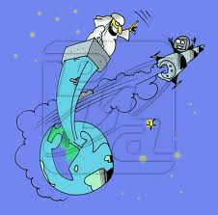
From the slides show, page 12, select 6 euphemisms and make a sentence with each one of them: an escort service, a sanitation engineer…
Invent 5 hyperboles, using images, they can be like jokes:
That building is so tall that Martians are seen from there.

